Slide 1
INF0 341 IPv4 and IPv6 Addresses Overview
By
Bob Larson

Slide 2
Topics
IPv4 Address Scheme
IPv4 Subnet Mask
Why Do We Need IPv6?
IPv4 vs. IPv6 Addresses
IPv6 Address Scheme

Slide 3
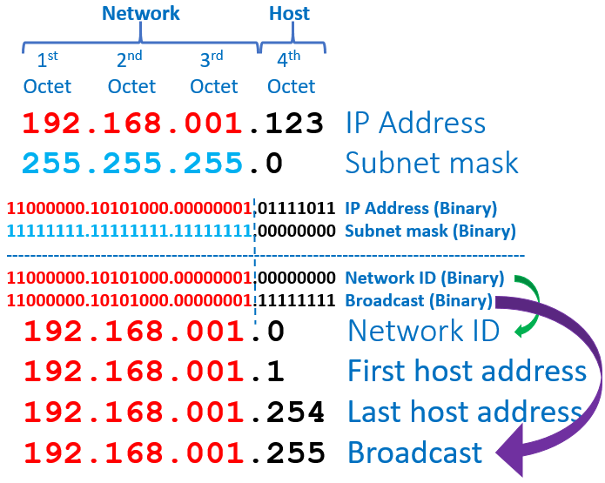
IPv4 Address Scheme
32 Bits | 4 Bytes | 4 Octets Binary
Converted to decimals and periods for humans
Two Parts
Network ID – first part
All hosts share same Network ID
Share same binary bits
Host (Device) ID – Last part
Each host has a unique Host ID
Subnet mask identifies Network ID
Contiguous binary 1s (then all 0s) Left-to-Right
What is left is the Host – all 0s in the mask
255 is eight 1s (8 bits) – Example 24 bit mask
Reserved Host addresses
First address identifies the entire network (subnet)
Last address is the broadcast address – goes to all hosts
First usable host usually assigned to the router
192.168.1.123/24 – alternative (CIDR) notation (24 is number of 1s in the subnet mask)

Slide 4
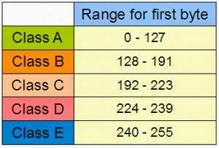
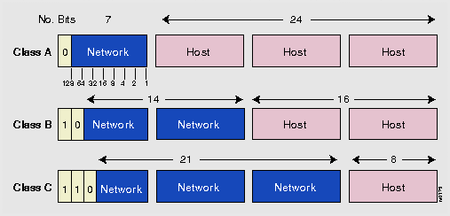
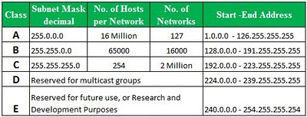
IPv4 Address Classes (History)
4.3 Billion Addresses
Remember Arpanet – its purpose and size
Nobody imagined the Internet of today
Mistakes were made (in hindsight)

Slide 5
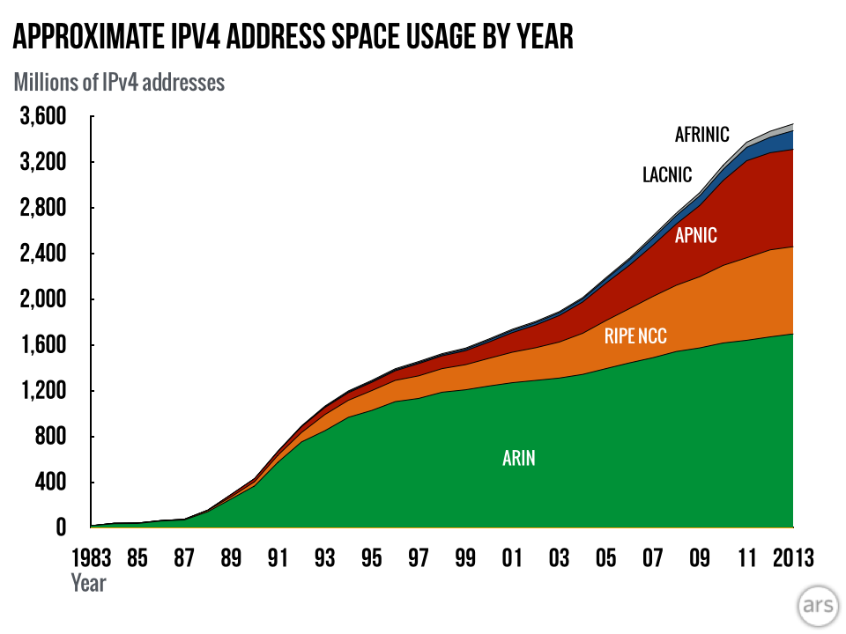
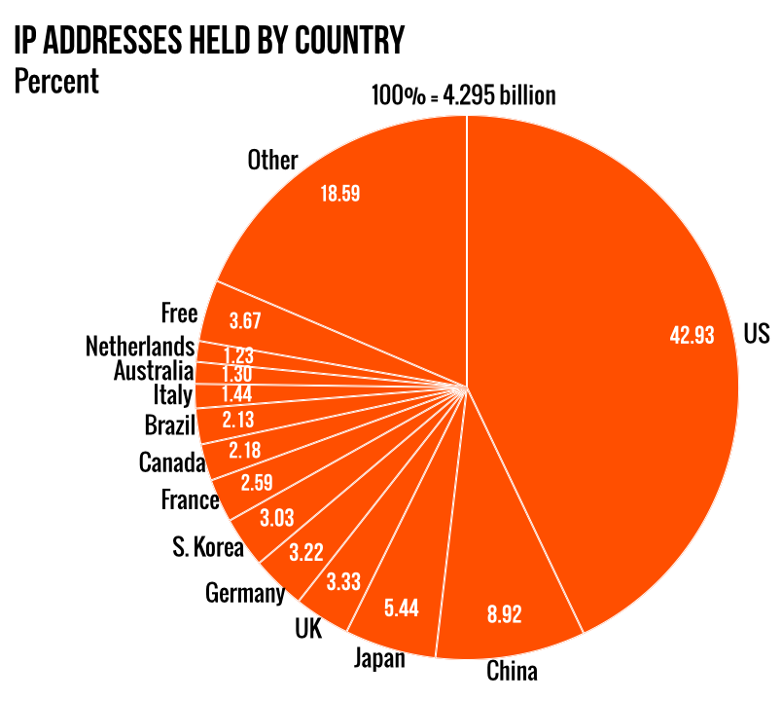
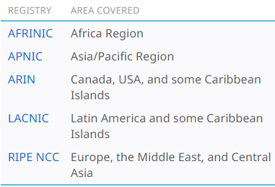
Why Do We Need IPv6?
Final stages: ARIN 2014, APNIC 2011, RIPE NCC 2012, LACNIC 2014
Source: arsTECHNICA 6/12/2-14

Slide 6
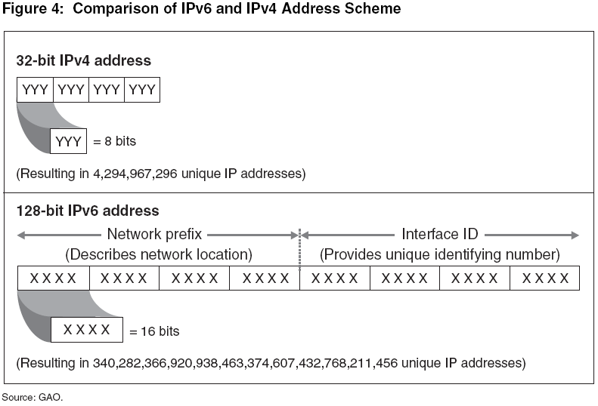
IPv4 vs. IPv6 Addresses
YYY – Decimal 0-255 or 256⁴ possible XXXX – HEX 0-FFFF or 65,536⁸ possible

Slide 7
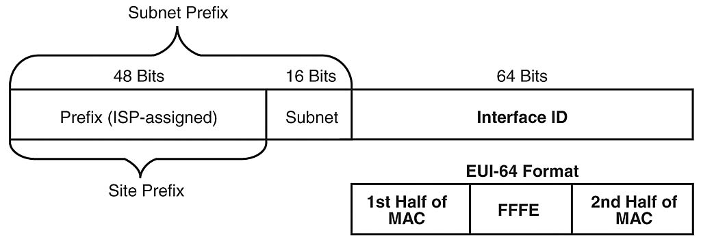
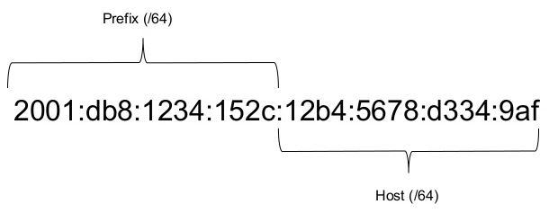
IPv6 Address Scheme
IPv6 Example
Prefix – Assigned by ISP
Subnet – Assigned by organization
Interface ID – Derived from EUI/MAC address

Slide 8
What can go wrong? What is Plan B?
The nations (politicians) of the world could:
Lose their nerve (fear of the unknowns – Y2K was ahead)
Choose to not understand the problem (Denial)
Kick the can down the road
Options to Dodge the Bullet
Private IPv4 addresses – NAT made this real
Subnet IPv4 networks to more efficiently use Public IPs
Constrict the supply of remaining IPv4 addresses
Result – IPv6 is crawling out

Slide 9
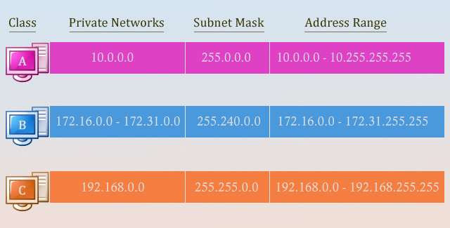
Private IP Addresses
Defined by Internet Assigned Numbers Authority (IANA):
RFC 1918 for IPv4*
RFC 4193 for IPv6
* IP address pool depletion
For use in any private network (no permission required)
Home, office, and enterprise LANs
Can’t be transmitted through the public Internet – routers won’t forward
Provides a level of anonymity to hosts in the private network
Side benefit for IPv4 but remains attractive to IPv6 network designers

Slide 10
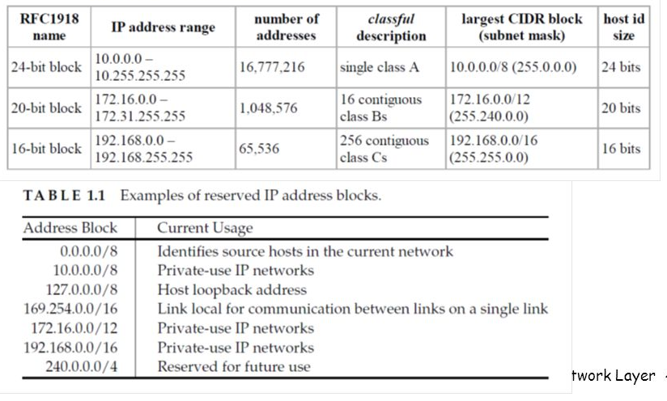
Reserved IP Addresses
0.x.x.x identifies all IPv4 addresses
Loopback routes electronic signals back to the source without processing or modification
To test the TCP/IP protocol stack
127.x.x.x – all 16,777,216 addresses
Link-local address is valid only within the network segment (link) or the broadcast domain that the host is connected to.
Not guaranteed to be unique beyond a single network segment
Routers therefore do not forward packets with link-local addresses
169.254.x.x – all 65,536 addresses
240-255.x.x.x reserved for future use

Slide 11
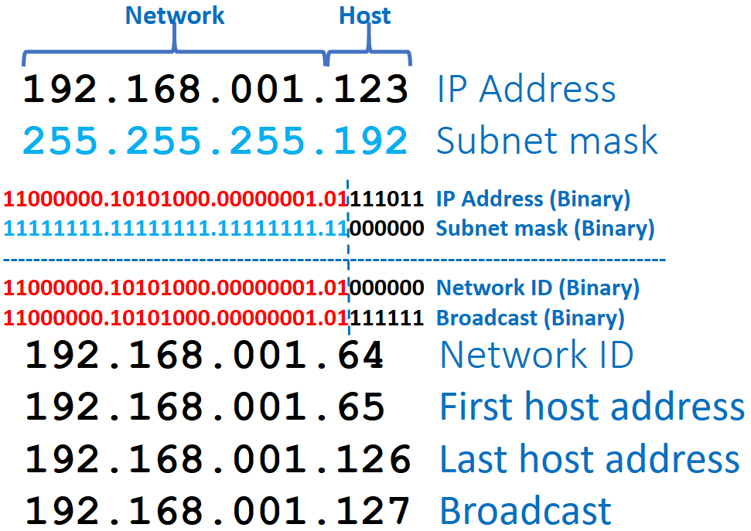
IPv4 Subnet Mask (Preview)
8 bits minimum 255.0.0.0
16,777,216 host addresses – 16,777,214 usable (Class A)
255.255.0.0 – 65,536 addresses, 65,534 usable (Class B)
255.255.255.0 – 256 addresses, 254 usable (Class C)
30 bits maximum 255.255.255.252
Four host addresses – two usable (point-to-point like to ISP)
Only valid mask numbers:
255 – 8 1s 11111111
128 – 1 1s 10000000
192 – 2 1s 11000000
224 – 3 1s 11100000
240 – 4 1s 11110000
248 – 5 1s 11111000
252 – 6 1s 11111100
254 – 7 1s 11111110
0 – 8 0s 00000000
Each bit in the mask doubles number of networks
Halves the number of hosts per network
Only one, if any, per mask
255.255.255.128 255.255.192.0 255.240.0.0
192.168.1.123/26 – alternative (CIDR) notation

Slide 12
Fin…

